Slide 1


TEXT CLASSIFICATION USING KERAS
This lecture allow you to do text classification starting from raw text. Text Vectorization has been used for word splitting & indexing.
SET UP
DATA LOADING
Let's generate the training, validation, and test datasets. The validation and training datasets are generated from two subsets of the train directory, with 20% of samples going to the validation dataset and 80% going to the training dataset.

Slide 2
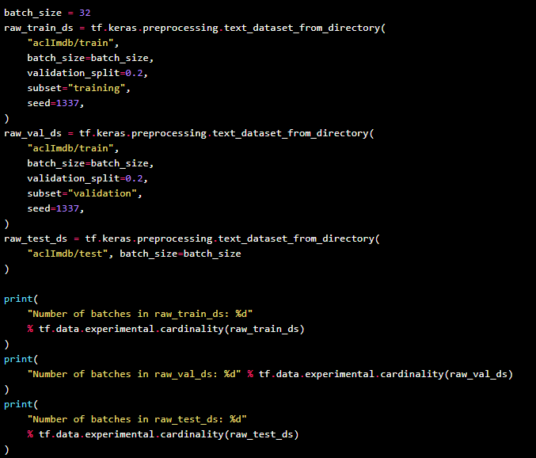
TRAINING AND VALIDATION
When using the validation_split & subset arguments, make sure to either specify a random seed, or to pass shuffle=False, so that the validation & training splits you get have no overlap.

Slide 3
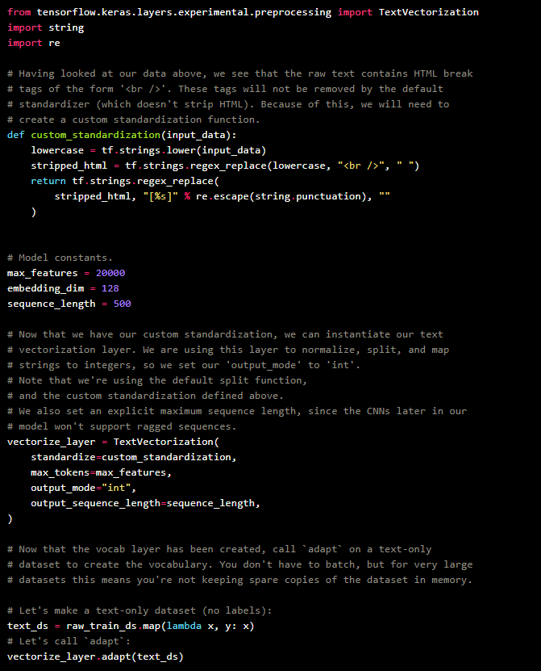
PREPARING DATA SET
DATA AUGMENTATION

Slide 4
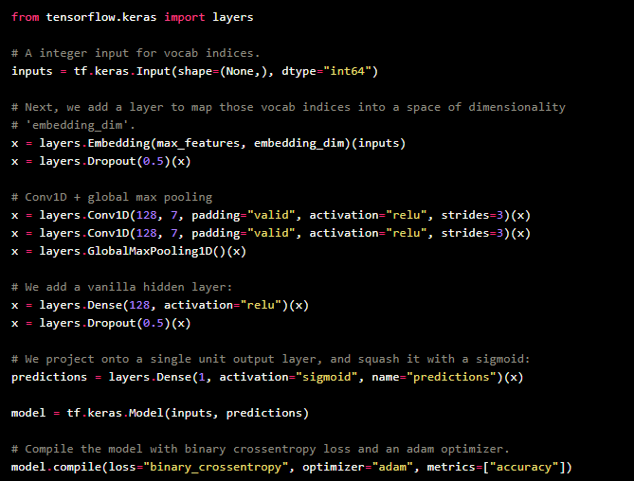
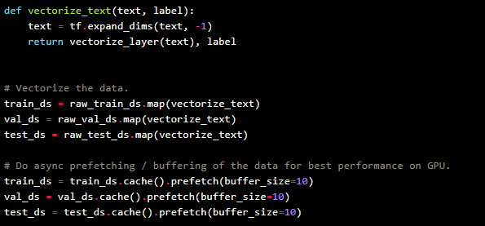
DATA VECTORIZATION & DATA MODEL

Slide 5

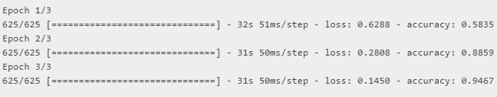
TRAINING AND TESTING OF MODEL

